Slide 1
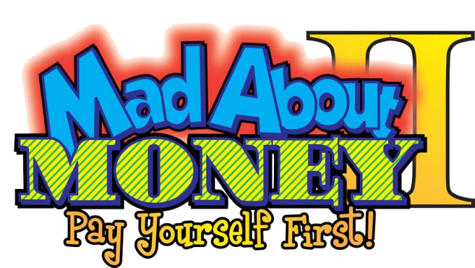
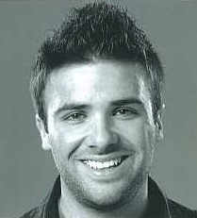
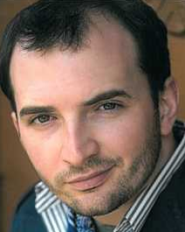
SPRING 2013
Tour dates: April 15th through May 17th
Program: Mad About Money II
Actors: Alex Ghattas & Michael Soldadi
Meet the Actors
Alex Ghattas
Michael Soldadi

