Slide 1
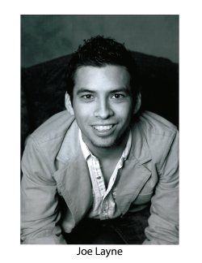
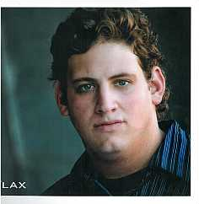
Winter 2013
Tour dates: January 28th through March 1st
Program: The Search for the Mountain Fountain
Actors: Joe Layne & Zach Flax
Meet the Actors
Joe Layne
Zach Flax

